Slide 1
Android Training
Managing the Activity Lifecycle
http://developer.android.com/training/index.html
师文轩，13920561100，shiwenxuan2003@hotmail.com

Slide 2
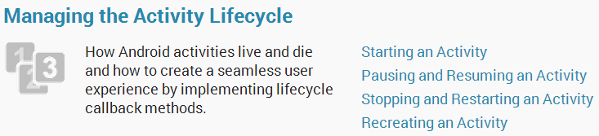
Managing the Activity Lifecycle

Slide 3
Intro
As a user navigates through, out of, and back to your app, the Activity instances in your app transition between different states in their lifecycle.
Within the lifecycle callback methods, you can declare how your activity behaves when the user leaves and re-enters the activity.

Slide 4
Lessons
Starting an Activity
Pausing and Resuming an Activity
Stopping and Restarting an Activity
Recreating an Activity

Slide 5
Starting an Activity
Unlike other programming paradigms in which apps are launched with a main() method, the Android system initiates code in an Activity instance by invoking specific callback methods that correspond to specific stages of its lifecycle.

Slide 6
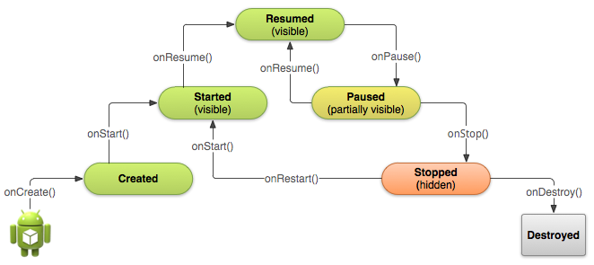
Understand the Lifecycle Callbacks

Slide 7
Depending on the complexity of your activity, you probably don't need to implement all the lifecycle methods.
The other states (Created and Started) are transient and the system quickly moves from them to the next state by calling the next lifecycle callback method.
That is, after the system calls onCreate(), it quickly calls onStart(), which is quickly followed by onResume().

Slide 8
Implementing your activity lifecycle methods properly ensures your app behaves well in several ways, including that it:
Does not crash if the user receives a phone call or switches to another app while using your app.
Does not consume valuable system resources when the user is not actively using it.
Does not lose the user's progress if they leave your app and return to it at a later time.
Does not crash or lose the user's progress when the screen rotates between landscape and portrait orientation.

Slide 9
Specify Your App's Launcher Activity
When the user selects your app icon from the Home screen, the system calls the onCreate() method for the Activity in your app that you've declared to be the "launcher" (or "main") activity.

Slide 10
You can define which activity to use as the main activity in the Android manifest file, AndroidManifest.xml, which is at the root of your project directory.
The main activity for your app must be declared in the manifest with an <intent-filter> that includes the MAINaction and LAUNCHER category.

Slide 11
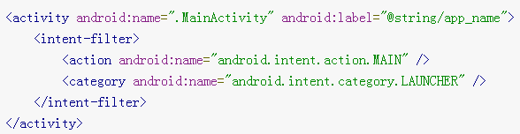
For example:

Slide 12
Create a New Instance
You must implement the onCreate() method to perform basic application startup logic that should happen only once for the entire life of the activity.
Once the onCreate() finishes execution, the system calls the onStart() and onResume() methods in quick succession.

Slide 13
For example, the following example of the onCreate() method shows some code that performs some fundamental setup for the activity, such as declaring the user interface (defined in an XML layout file), defining member variables, and configuring some of the UI.

Slide 14
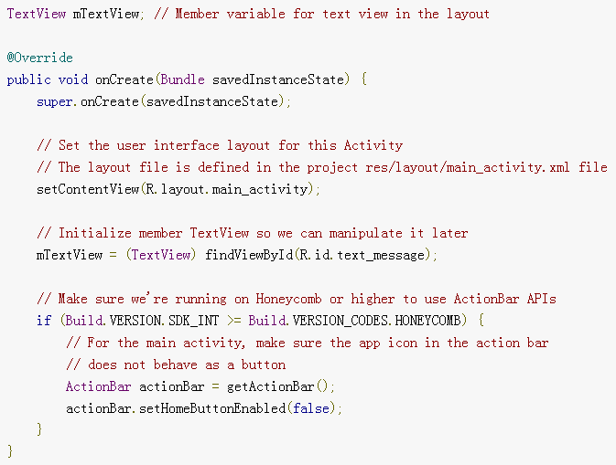

Slide 15
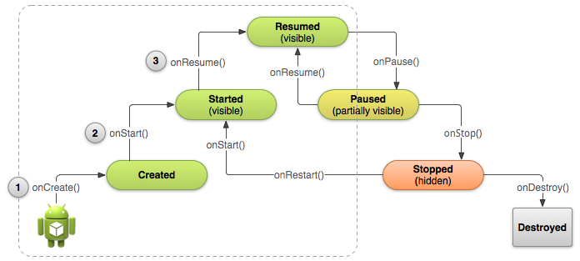
Another illustration of the activity lifecycle structure with an emphasis on the three main callbacks that the system calls in sequence when creating a new instance of the activity: onCreate(), onStart(), and onResume().

Slide 16
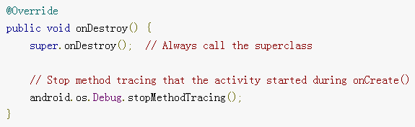
Destroy the Activity
While the activity's first lifecycle callback is onCreate(), its very last callback is onDestroy().

Slide 17
Most apps don't need to implement this method because local class references are destroyed with the activity and your activity should perform most cleanup during onPause() and onStop().
However, if your activity includes background threads that you created during onCreate() or other long-running resources that could potentially leak memory if not properly closed, you should kill them during onDestroy().

Slide 18
Pausing and Resuming an Activity
During normal app use, the foreground activity is sometimes obstructed by other visual components that cause the activity to pause.
As your activity enters the paused state, the system calls the onPause() method on your Activity
If the user returns to your activity from the paused state, the system resumes it and calls the onResume() method.

Slide 19
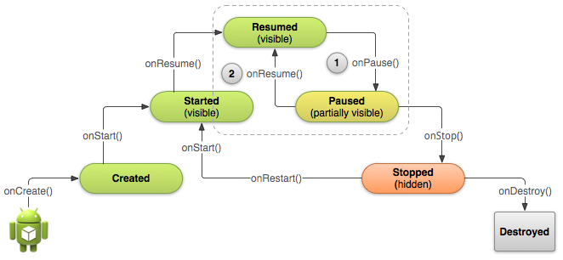
When a semi-transparent activity obscures your activity, the system calls onPause() and the activity waits in the Paused state (1). If the user returns to the activity while it's still paused, the system calls onResume() (2).

Slide 20
Pause Your Activity
When the system calls onPause() for your activity, it technically means your activity is still partially visible, but most often is an indication that the user is leaving the activity and it will soon enter the Stopped state.

Slide 21
You should usually use the onPause() callback to:
Stop animations or other ongoing actions that could consume CPU.
Commit unsaved changes, but only if users expect such changes to be permanently saved when they leave (such as a draft email).
Release system resources, such as broadcast receivers, handles to sensors (like GPS), or any resources that may affect battery life while your activity is paused and the user does not need them.

Slide 22
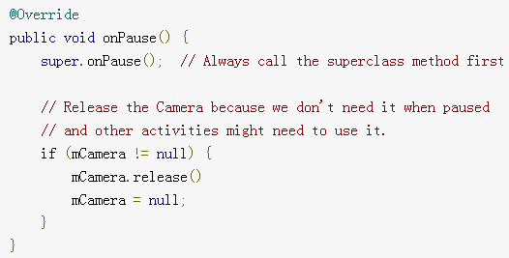
For example, if your application uses the Camera, the onPause() method is a good place to release it.

Slide 23
Resume Your Activity
When the user resumes your activity from the Paused state, the system calls the onResume() method.

Slide 24
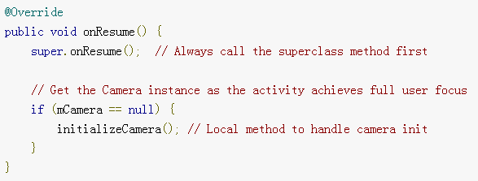
The following example of onResume() is the counterpart to the onPause() example above, so it initializes the camera that's released when the activity pauses.

Slide 25
Stopping and Restarting an Activity
There are a few of key scenarios in which your activity is stopped and restarted:
The user opens the Recent Apps window and switches from your app to another app:
The activity in your app that's currently in the foreground is stopped.
If the user returns to your app from the Home screen launcher icon or the Recent Apps window, the activity restarts.

Slide 26
The user performs an action in your app that starts a new activity:
The current activity is stopped when the second activity is created.
If the user then presses the Back button, the first activity is restarted.
The user receives a phone call while using your app on his or her phone.

Slide 27
The Activity class provides two lifecycle methods, onStop() and onRestart(), which allow you to specifically handle how your activity handles being stopped and restarted.
Unlike the paused state, which identifies a partial UI obstruction, the stopped state guarantees that the UI is no longer visible and the user's focus is in a separate activity (or an entirely separate app).

Slide 28
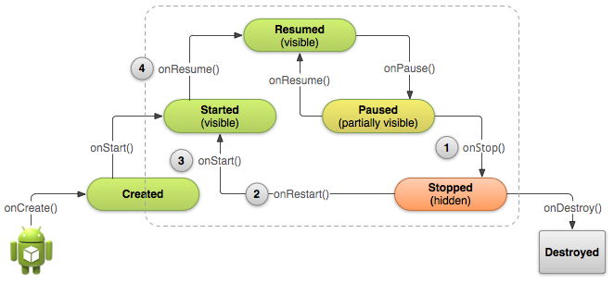

Slide 29
Stop Your Activity
When your activity receives a call to the onStop() method, it's no longer visible and should release almost all resources that aren't needed while the user is not using it.
Although the onPause() method is called before onStop(), you should use onStop() to perform larger, more CPU intensive shut-down operations, such as writing information to a database.

Slide 30
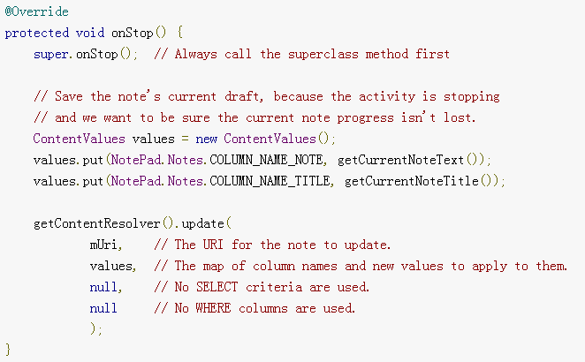
For example, here's an implementation of onStop() that saves the contents of a draft note to persistent storage:

Slide 31
Start/Restart Your Activity
When your activity comes back to the foreground from the stopped state, it receives a call to onRestart().
For example, because the user might have been away from your app for a long time before coming back it, the onStart() method is a good place to verify that required system features are enabled:

Slide 32
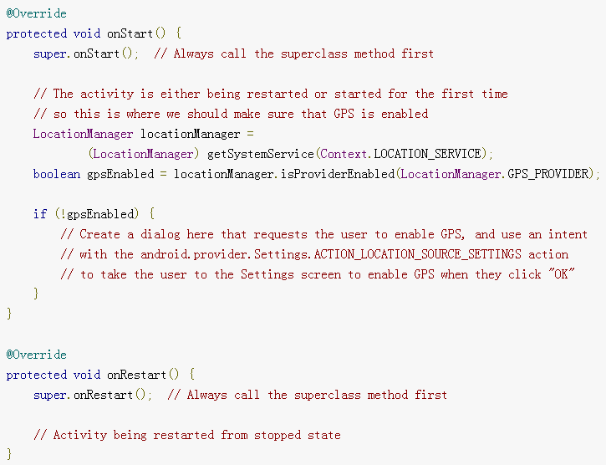

Slide 33
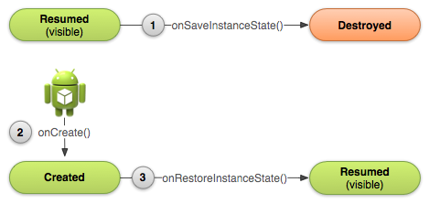
Recreating an Activity
To save additional data about the activity state, you must override the onSaveInstanceState() callback method.

Slide 34
If the system must recreate the activity instance later, it passes the same Bundle object to both the onRestoreInstanceState() and onCreate() methods.
Caution: Your activity will be destroyed and recreated each time the user rotates the screen.

Slide 35
Save Your Activity State
As your activity begins to stop, the system calls onSaveInstanceState() so your activity can save state information with a collection of key-value pairs.

Slide 36
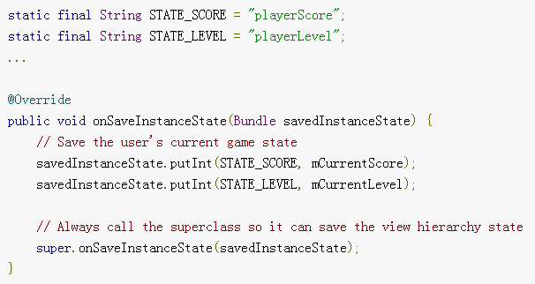
For example:

Slide 37
Restore Your Activity State
When your activity is recreated after it was previously destroyed, you can recover your saved state from the Bundle that the system passes your activity.
Both the onCreate() and onRestoreInstanceState() callback methods receive the same Bundle that contains the instance state information.

Slide 38
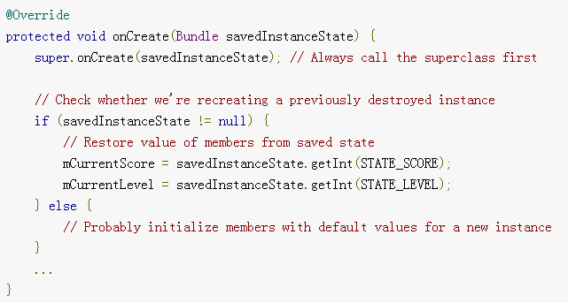
For example, here's how you can restore some state data in onCreate():

Slide 39
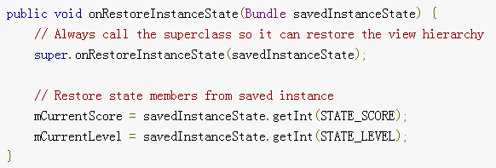
Instead of restoring the state during onCreate() you may choose to implement onRestoreInstanceState(), which the system calls after the onStart() method.

